Slide 1




ADP Time Entry
Employee Functions
Workforce Now (New Experience) - Essential Time

Slide 2
ADP Update/Announcement
We were informed earlier this week that our group has the option to setup the newest version of the construction functionality knows as Workforce Now for Construction (WFN4C) which launched recently.
This is the newest version of Contractor Central and if we wish to move forward it would delay setup to a 4/1 start versus 2/4.
It offers more automation and is built within the payroll system rather than export/import to a separate system for the calculations.
We have the option to keep the course and stick with Contractor Central and a 2/4 go live but we want to explore this option.
If we do not elect to implement now we cannot do so for another 2 years, due to resource and bandwidth availability within ADP’s group.
Meeting Tuesday 1/30 to discuss and finalize direction.

Slide 3
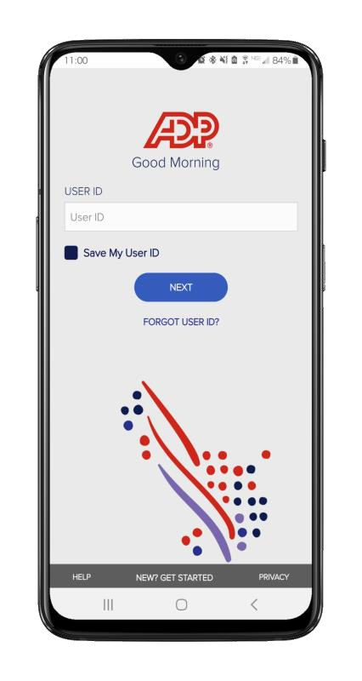
Mobile Punch/Adding Hours
The ADP Mobile App allows employees to record their time while on the go.

Slide 4
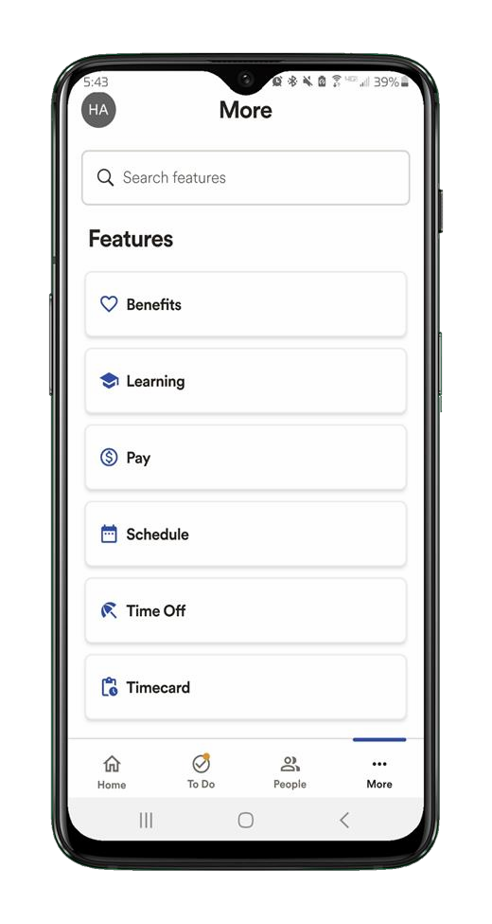
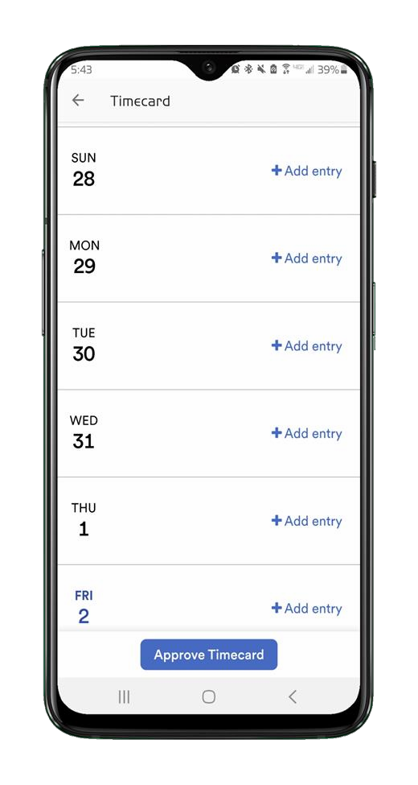
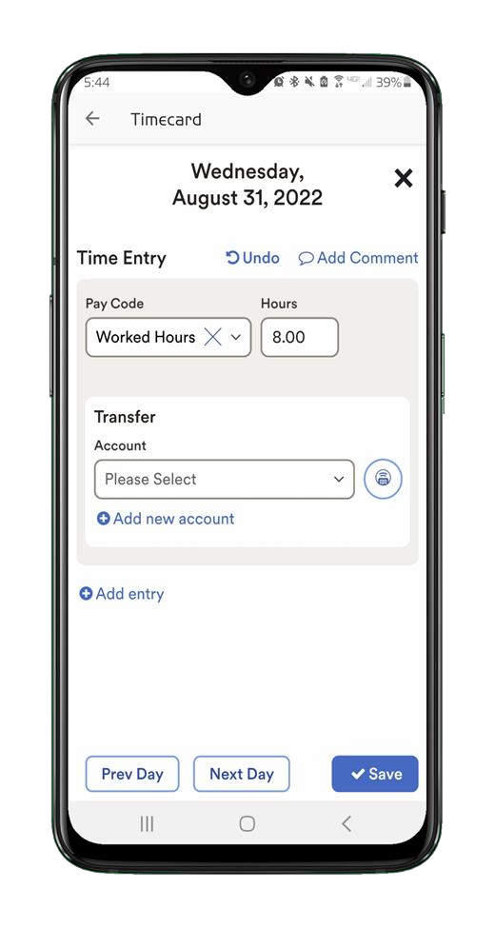

Tap More then tap on
Timecard
Tap +Add Entry
Select the Pay Code, then enter the hours.

Slide 5
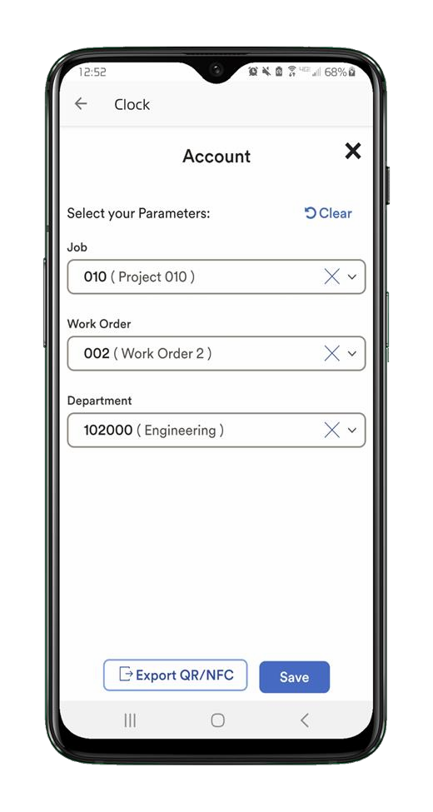
Select each Labor
Charge Field (job, sub job, cost code, etc.), tap Save
Legend
Job: Where work is performed (25-01-0460 Camp Shade).
Sub job: Continuation of the parent Job. Items added to a Sub Job will appear in the Sub Job's invoice and therefore the Sub Job can be invoiced separately (001).
Cost Code: Group of individual costs based on their nature or function (01-001 General Conditions).
Category: Always choose (L).
Cert Class: Only applies to Carpenters & Laborers. For Carpenters & Laborers, Hard Coded(“Carpenter” or “Laborer”).
Union Classification: Only applies to Carpenters & Laborers. For Carpenters & Laborers, Hard Coded(“Apprentice 55, Journeyman, etc.”).
Union: Only applies to Carpenters(union “326”) hard coded.
Day of week: Select applicable day hours apply too.
GL Code: Hard Coded, if need to change, change simply click drop down and select corresponding GL code.
Tap +Add new account

Slide 6
Desktop Punch/Adding Hours
The ADP Mobile App allows employees to record their time while on the go.

Slide 7
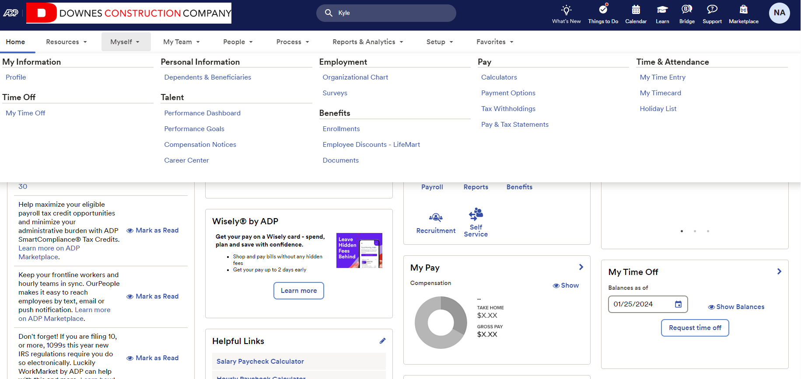

Slide 8
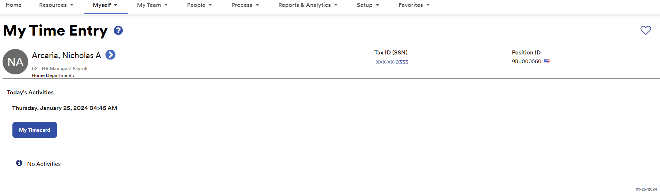

Slide 9
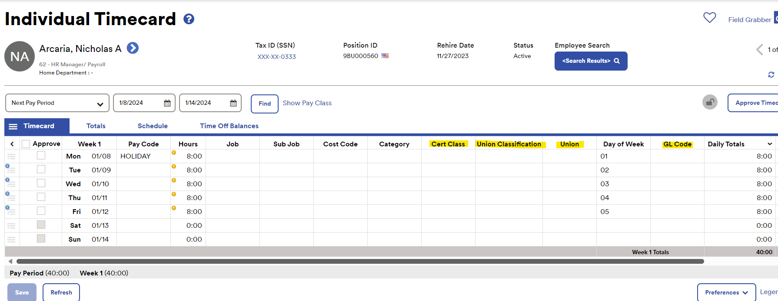

Slide 10
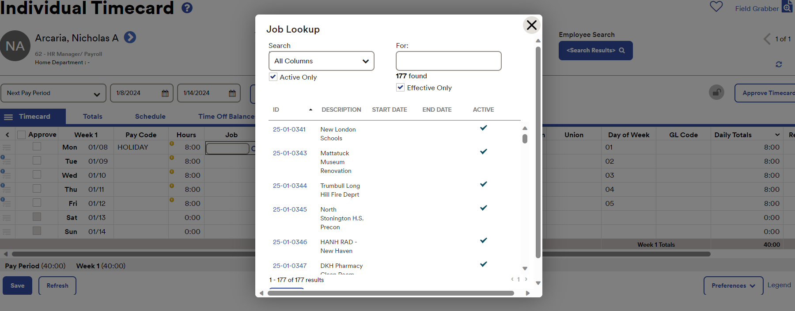

Slide 11
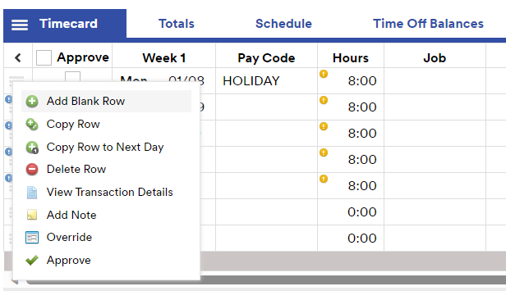
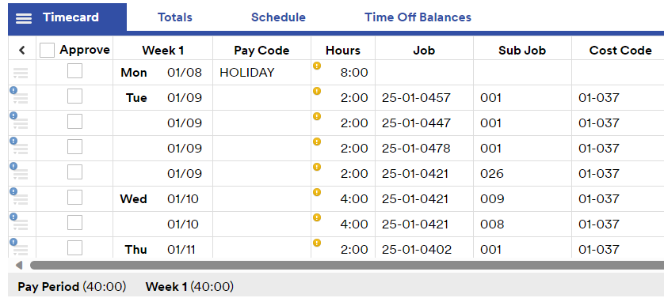
Adding multiple line entries to one day
Click the three line icon to the left of the day
Below screenshot option pops up
Select “Add Blank Row”
Enter additional line entry

Slide 12
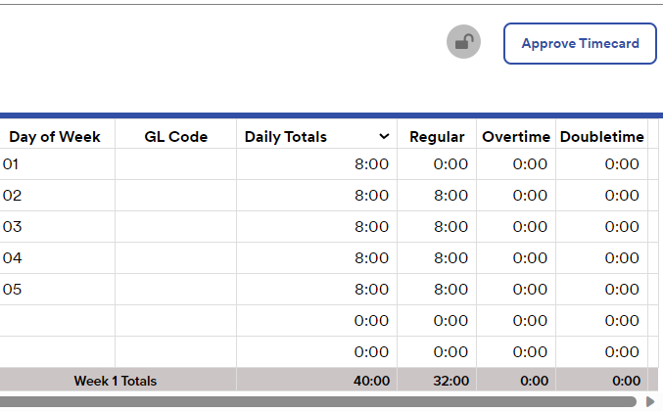
Weekly time is reflected at the very right side of the individual timecard and is broken down into Regular, Overtime, and Double-time for those it applies to.

Slide 13
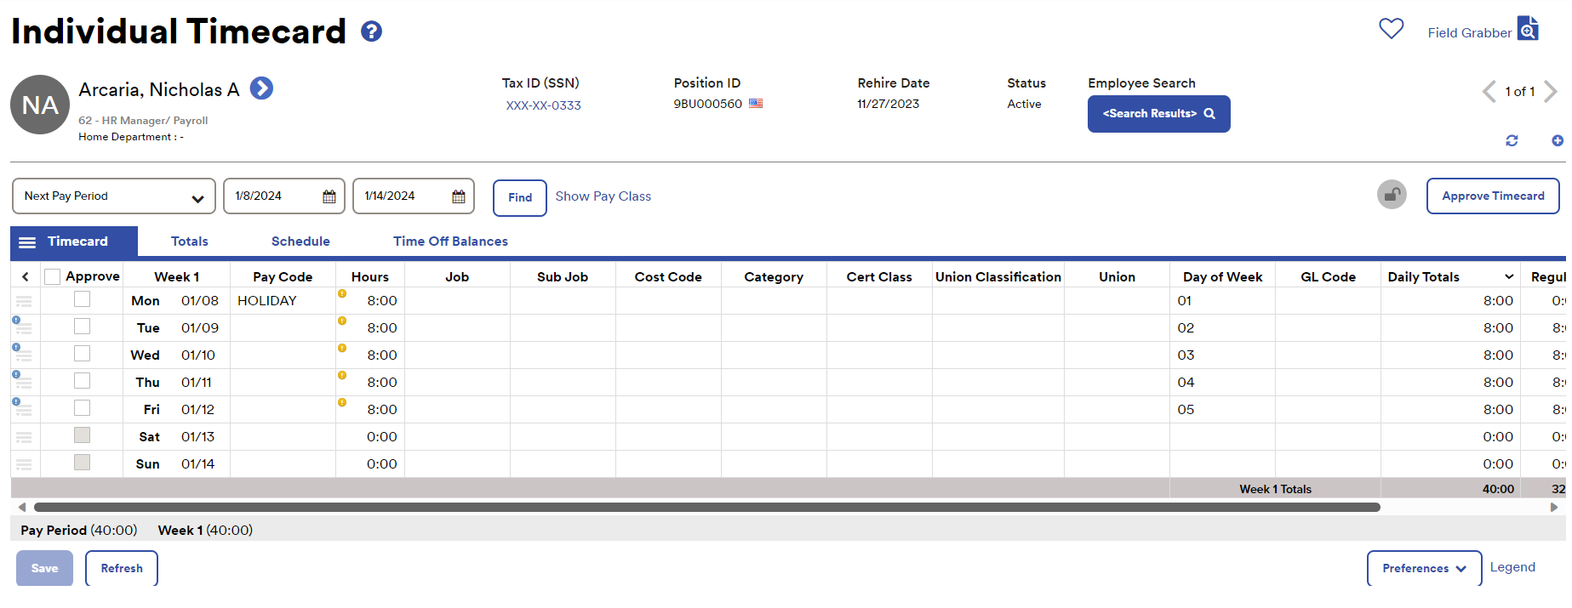
Once time is entered and reviewed, click save and it will route to the Time and Attendance Supervisors for their review and approval.

Slide 14

Deleting hours from your timesheet
Note: This function is only available to employees who have edit privileges
to their own timesheet.

Slide 15
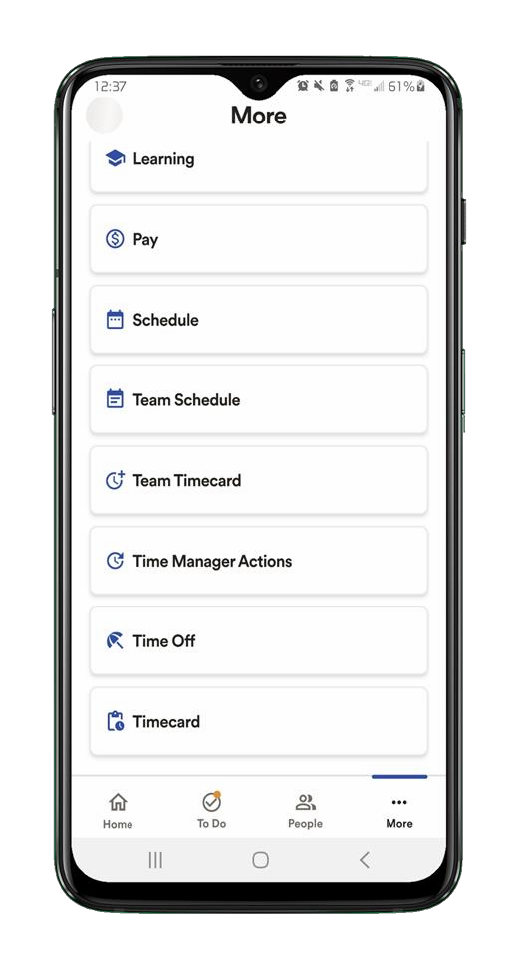
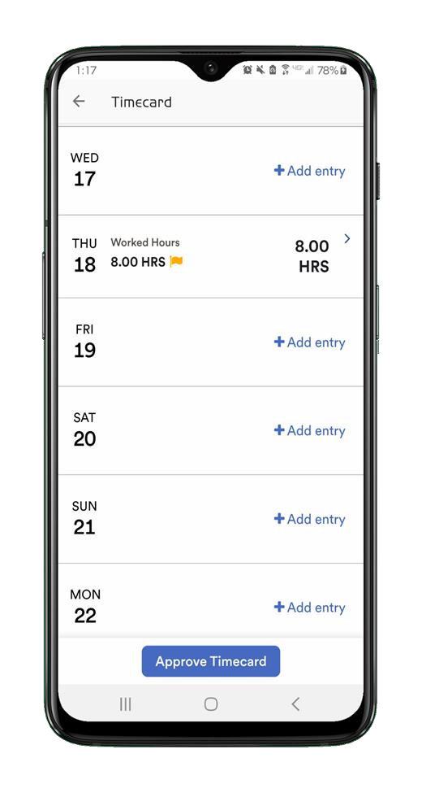
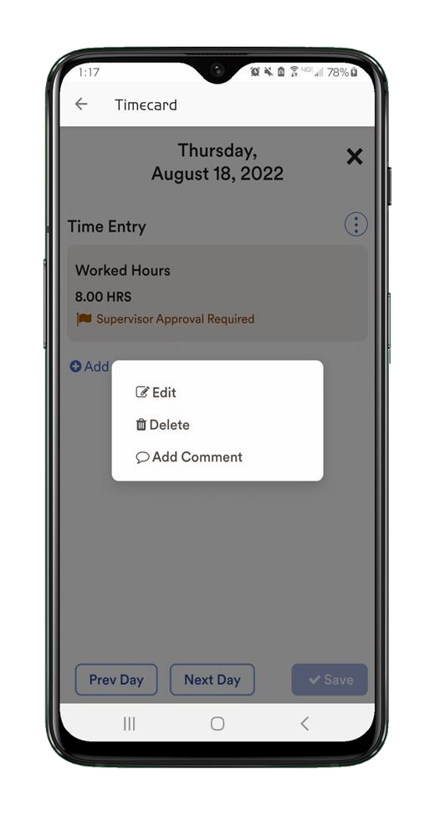
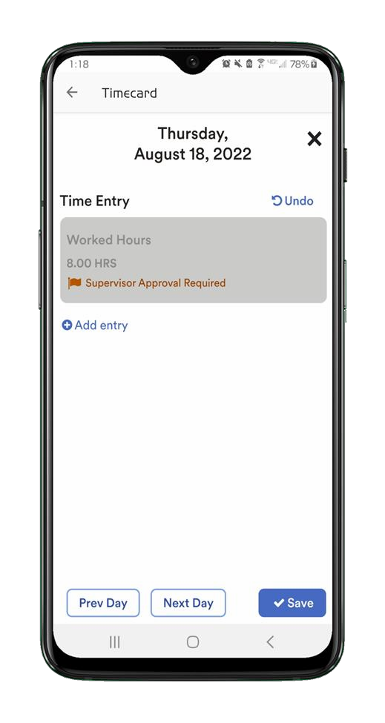
Tap More then tap on
Timecard
Tap into the time pair
Tap the Menu icon, then
tap Delete
Click Save to delete

Slide 17
ADP PTO Requests
Employee Functions
Workforce Now (New Experience) - Essential Time

Slide 18
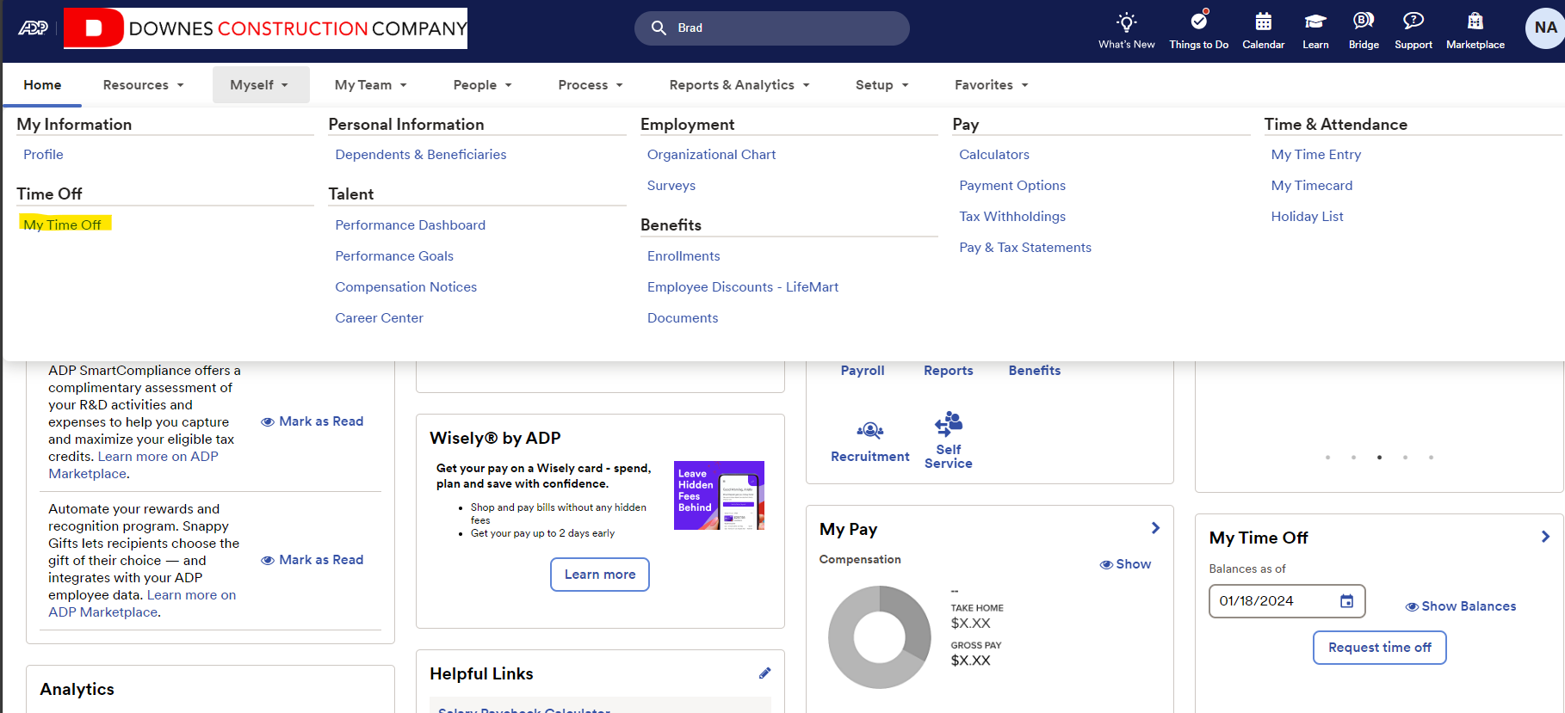
Myself-> Time off-> My Time Off

Slide 19
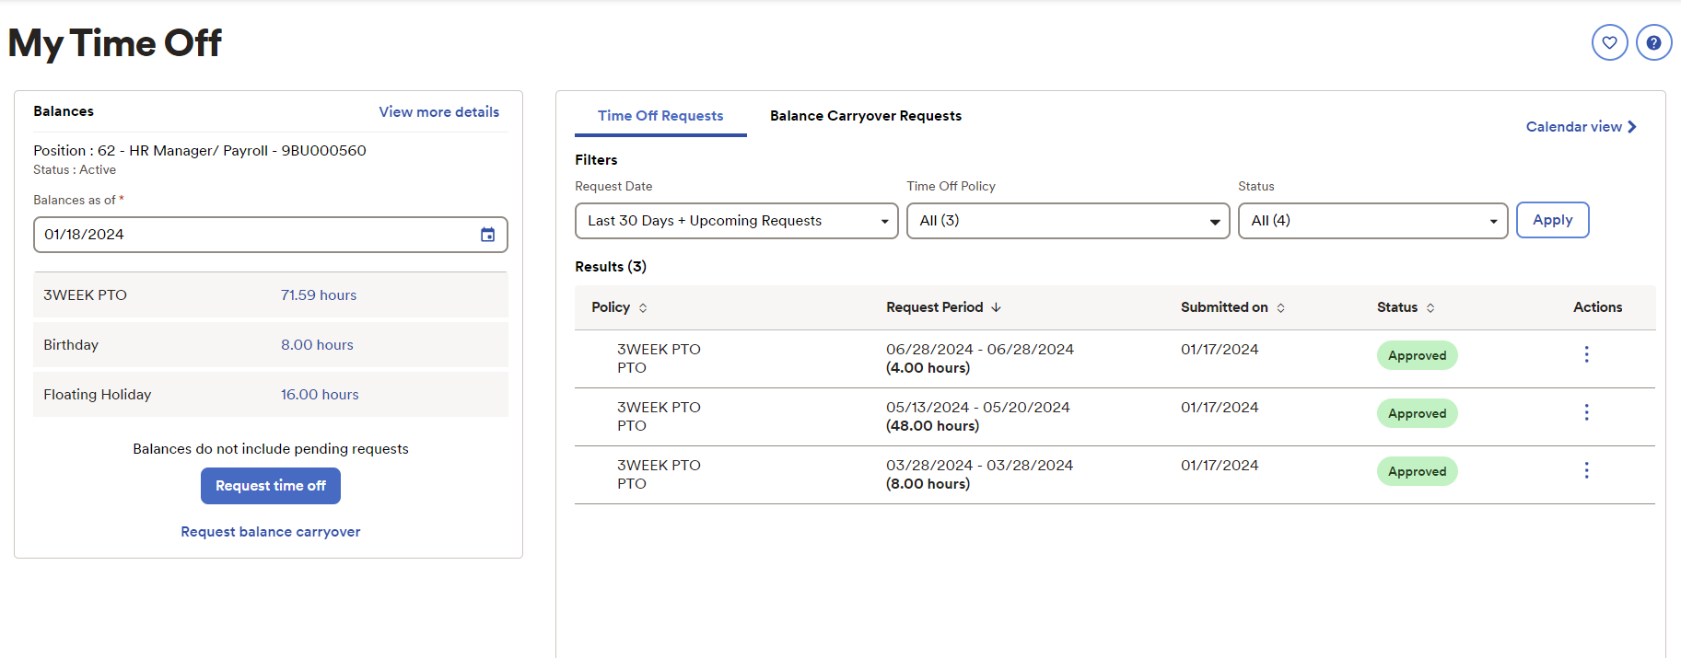

Slide 20
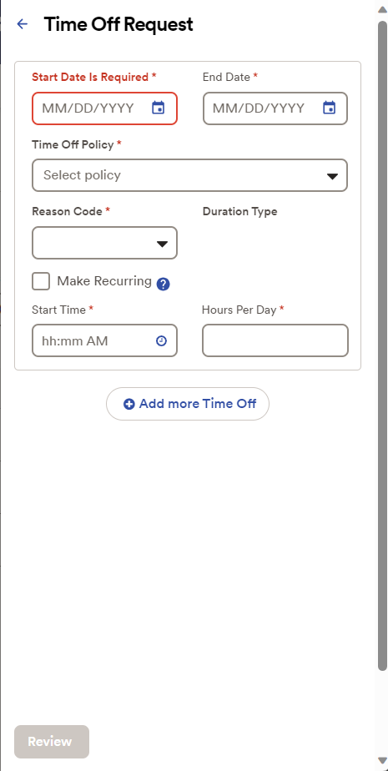
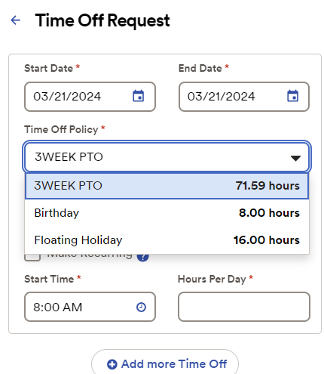

Slide 21
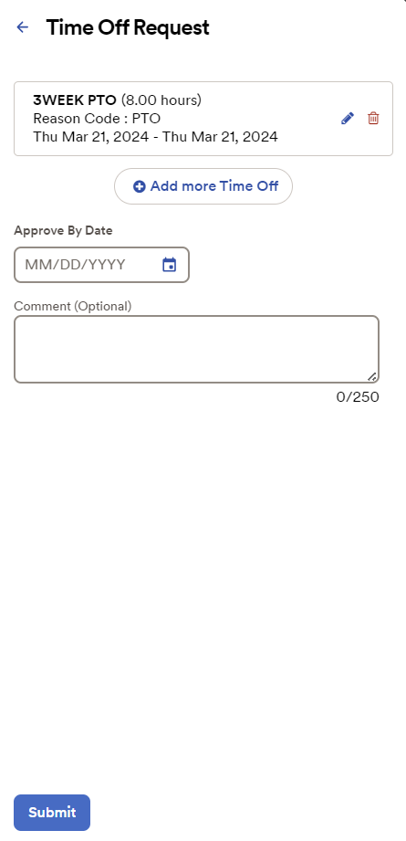

Slide 22
Questions?

